Slide 1


21. & 22. Juni 2022
Satelliten-Workshop
Block 4 – Test- & Demonstration-Environments
Prof. Dr. Dirk Kutscher

Slide 2
Key Question & Expected Outcome
When and where will the projects establish a test and demonstration environment
Establish for each project an understanding with respect to the following aspects:
Methodology for validation and test:
How is ORAN technology (components) validated and tested?
How are use cases evaluated?
Test environments:
Which test environments / testbeds are available?
Where are they located?
Time plan for availability / extension of testbeds
Demonstration environments:
Which demonstration environments are available; and do they differ from the test environments?
Where are they located?
Time plan for availability / extension of demo environment
Supported use cases
Potential collaboration between projects
← note: one slide per project
← note: one slide for each testbed per project
If Testbed and demonstration environment are the same, combine them in one slide
← note: one slide for each testbed per project
← Open discussion to complement existing, bilateral contacts between projects

Slide 3
<Project_Acronym>
<Long_Project_Name>
<Key contact project coordinator (Name & e-mail)>
<Key contact “block 4” topics (e.g. task lead; Name & e-mail)>

Slide 4
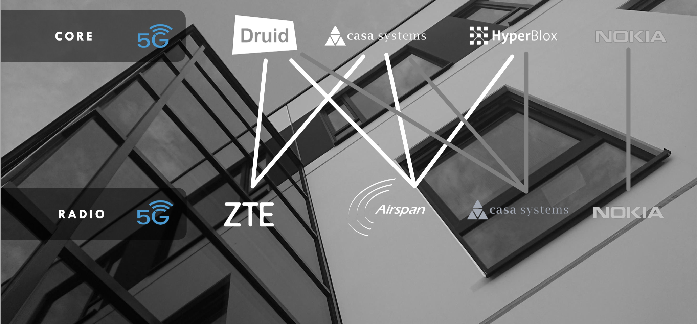
MAVERIC
Methodology for validation and test

Slide 5
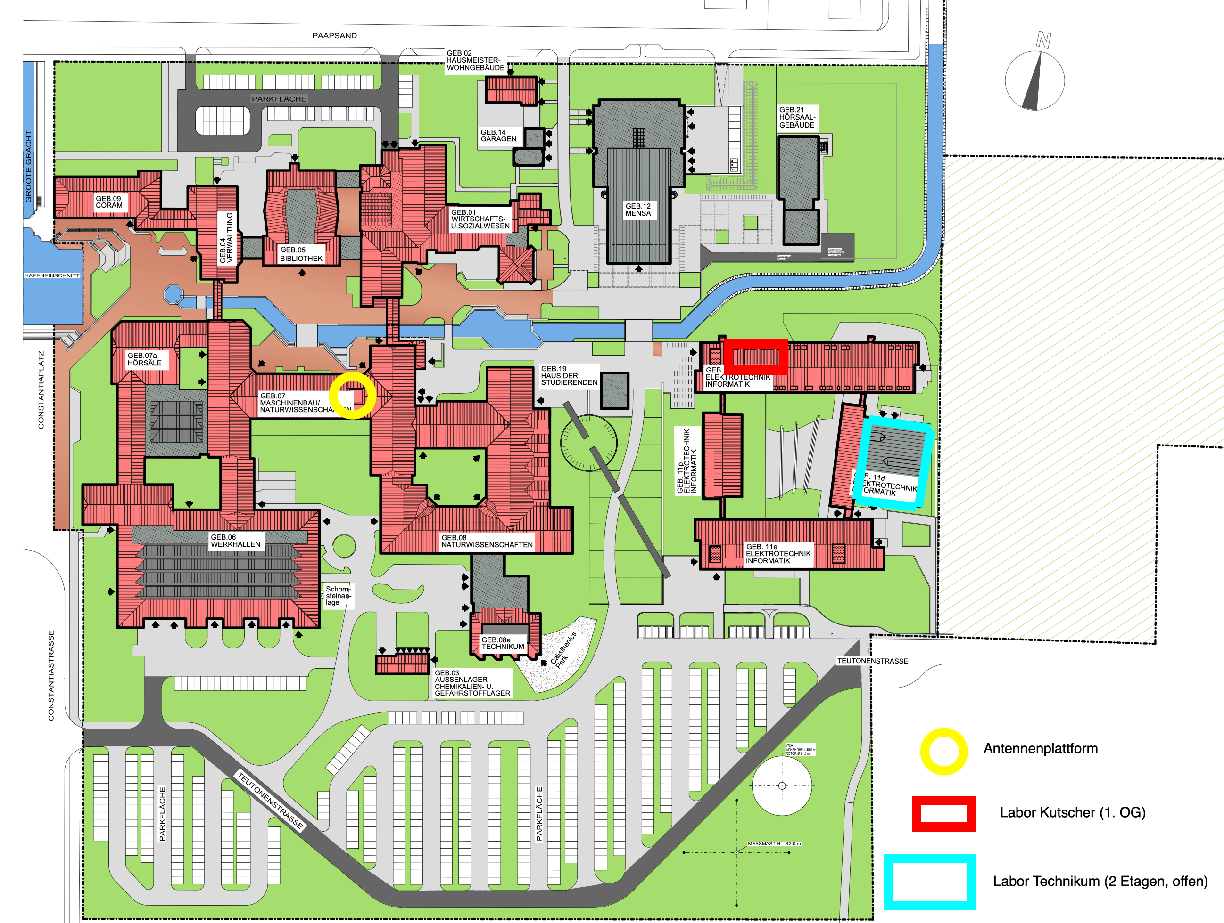
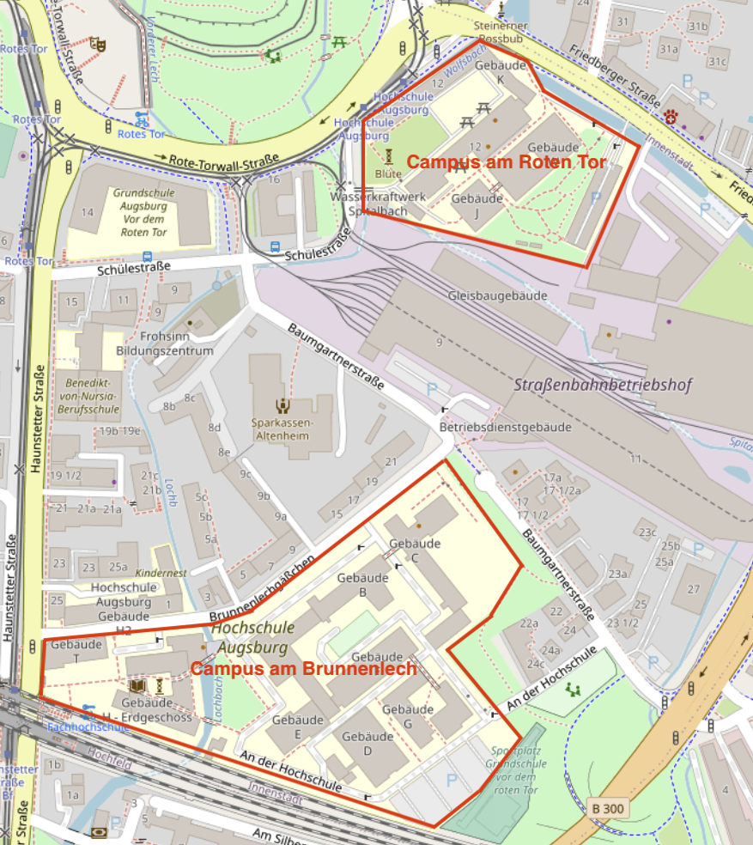
MAVERIC
University Development Lab Networks: in 2022
Emden
Augsburg

Slide 6
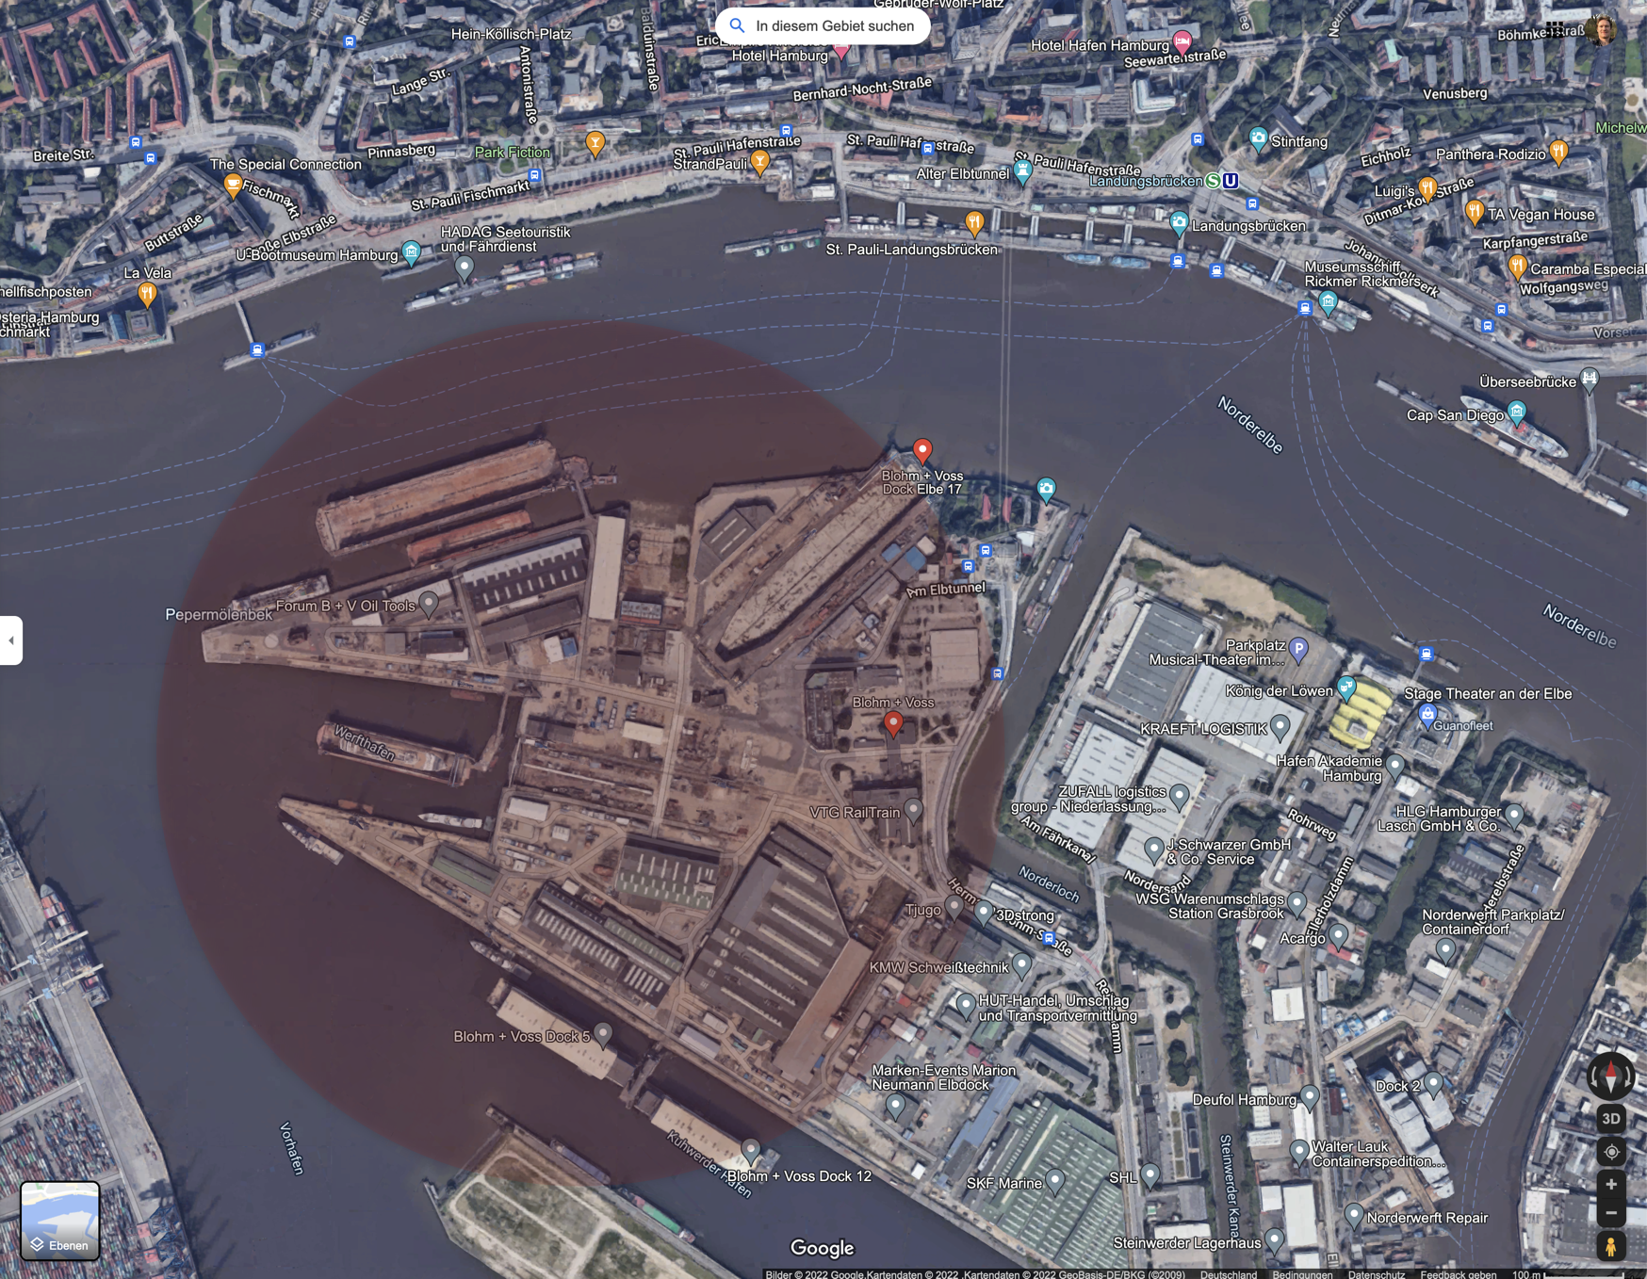
MAVERIC
NVL’s Blohm&Voss Site: early 2023
Network planning work in progress
Evaluation will consider functional requirements but also operational and economical aspects
For example: Overall comparison with existing WiFi infrastructure

Slide 7
<Project_Acronym>
← note: one slide for each demo environment per project
If Testbed and demonstration environment are the same, combine them in one slide
<Demonstrator_Name>: Descripton and timeplan

Slide 8
Potential collaborations
Topics
Deployment blueprints
Architecture blueprints
Interop experience
Ways of working
Mailing list?
Git repo & Wiki (i.e., github, gitlab)?
Caveats
Proprietary knowhow and commercial interests
NDAs (within project, with vendors)
Overhead
Potential outcome
Publication, recommendations?
Workshops?
Talks at industry fairs etc.
MAVERIC collaboration budget
For collaboration with pilot project

Slide 9
Potential collaborations
Please add here bullets regarding potential collaboration that you would like to discuss. If you do not have specific points so far, it is ok to leave this slide empty. We will combine all bullets into one slide for a joint discussion

Slide 10
Wrap-Up & Next Steps
Not to required to be filled out by each satellite project. Just a placeholder to give an idea on potential wrap up topics
Potential aspects to consider:
Collaborations
Equipment exchange
Testbed interconnect – required, useful ?
Etc.

